Slide 1
Raspberry Pi & Linux OS
An Introduction- Part 2

Slide 2
Raspbian OS in Raspberry Pi
Since Raspbian is a linux based Operating System for Raspberry Pi hardware, most of the commands executed on Raspberry through terminal window are Linux based commands

Slide 3
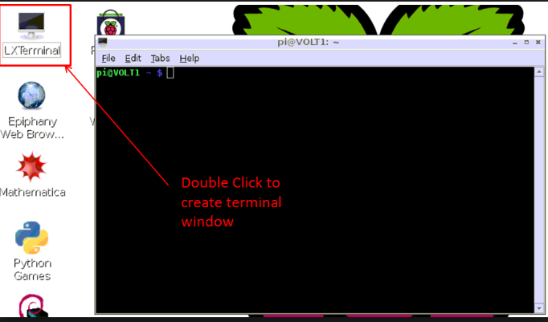
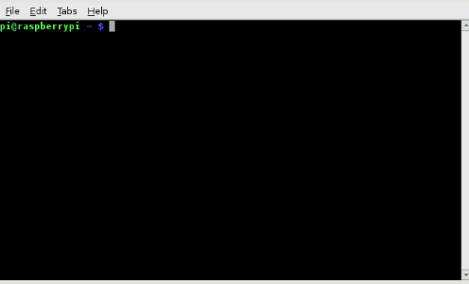
Starting LXTerminal
On the Raspberry Pi (running Raspbian), the default terminal application isLXTerminal
Your default username is Pi and hostname is raspberrypi
Notes:
https://www.raspberrypi.org/documentation/usage/terminal/

Slide 4
Directory Description
root : Home folder of the Linux super user
tmp : Temporary files
usr : Secondary hierarchy
bin : Essential command binaries
home : User login and data folders
lib : Essential shared libraries and kernel modules
pi: The default home directory on Raspberry is /home/pi/

Slide 5
Important Commands on terminal window
1) ls : “ls” command displays the list of files present in a given directory.
2) cd : “cd” or change directory command allows the user to traverse through the directories and file paths.
3) sudo: “sudo” allows users to run programs with the security privileges of super user or root or administrator.
4) nano filename.py : “nano” allows the user to create a file and .py is the extension for saving a python script file in the home directory. You can change the directory of the new file using cd command followed by nano .
Notes:
https://www.raspberrypi.org/documentation/linux/usage/commands.md

Slide 6
Executing Python Files from the Command Line/ Terminal Window
Open Console or Terminal Window on your Raspi Desktop.
You can also write a python script from the terminal window using nano hello.py and save it with the .py extension in the desired directory using cd command.
You can write a Python file in a standard editor like IDLE and run it as a Python script from the command line. Just navigate to the directory the file is saved (use cd and ls for guidance) and run with python, e.g. python hello.py.
Notes:
https://www.raspberrypi.org/documentation/usage/terminal/
https://www.raspberrypi.org/documentation/usage/python/

Slide 7
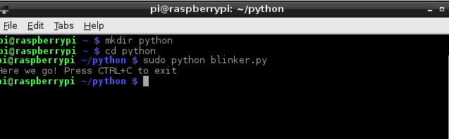
Example of running python script using Command Line terminal Window:

Slide 8
Remote Login Using SSH (DIY)
Secure Shell (ssh) is a network protocol which allows remote control of Raspberry Pi from another computer over the network.
Provides access to the Command Line and not to the Full Desktop Environment.
You can enable or disable the SSH server on your Raspberry Pi (it is enabled by default).
To Enable SSH, in the Terminal, enter sudo raspi-config, enable the ssh, finish and exit the menu.
Use a third-party SSH client software on your Windows System (like puTTy or TeraTerm) and access Raspberry Pi by entering it’s I.P. Address, user (pi) and password (raspberry).
To check Raspberry Pi’s I.P. Address, enter ifconfig in the terminal.

